Slide 1
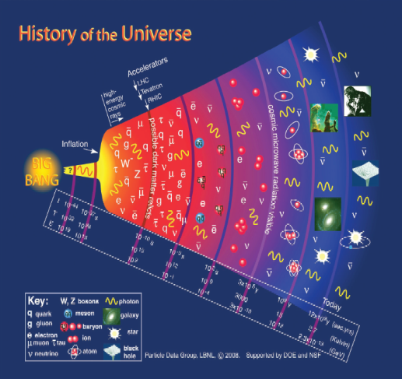
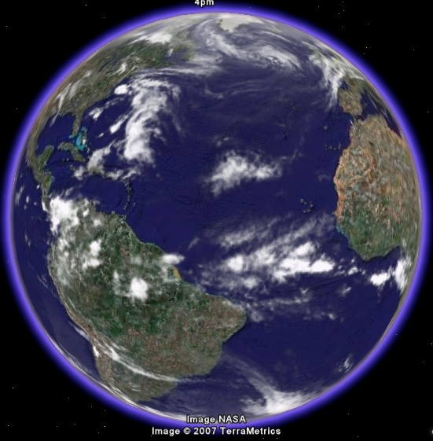
Theoretical Particle & Cosmology efforts in Taiwan – a small community Xiao-Gang He NCTS

Slide 2
Theoretical Particle&Cosmology efforts in Taiwan
Taiwan HEP and Cosmology is a small community of order 60(30 in th) faculties. Total 150 (80 in th) people, including faculties, postdocs and graduate students.

Slide 3
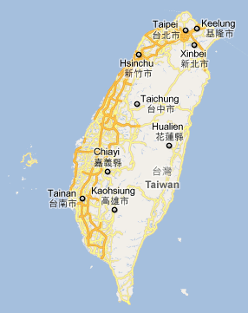
AcademiaSinica, Natl Taiwan U
Natl Taiwan Normal U. Tamkang U
Major institutions with THEP groups
Natl Central U
Chung-Yuan U
NCTS
Natl Chiao-Tung U
Natl Tsing-Hua U
Natl Chung-Cheng U
NDHU
Natl Cheng-Kung U
Natl Sun Yat-sen U

Slide 4
Funding
National Science Council (NSC 国科会)
Personal grant: about 60 PIs, about NT$0.8mil/Year (th), HEP exps. Total
NT$60mil/Year, Astro phys,More. About 60 postdocs.
Academic Submit （攻顶） grant of order NT$10 ~ 20mil/year. Academic Excelence (卓越领航), 0.5 ~ 1.0 mil/year
Ministry of Education
5Y/50b Academic Excellence program support basic research,
through universities, providing postdocs (~20)and etc. Examples: NTU
Center for Advanced Studies of Theoretical Sciences, hep-拔尖 project…
Academia Sinica: Always a resource for HEP&Cosmology in some
way (~10 postdocs)
National Center for Theoretical Sciences(NCTS)
under NSC (physics NT$40mil/Year), ~9 postdocs

Slide 5
Three branches:
NCTSm (NTHU&NCTU), NCTSn (NTU) and NCTSs (NCKU)
Coordinates theoretical physics efforts in Taiwan
Twelve Focus groups (bottom up)
covering particle, astrophysics, cosmology, condensed
matter physics, bio-physics, computational physics.
Center Initiatives (top down): Computational physics,
material sciences.

Slide 6
Focus groups related to HEP and Cosmology 1. Gravitation 2. Cosmology and Particle Astrophysics 3. LHC Physics 4. String 5. Lattice QCD and Hadron Physics

Slide 7
Major Experimental programs LHC (ATLAS, CMS); SUPER-B; DAYA BAY; TEXONO; Fermilab E-906;CDEX; J-PARC… ARMIBA; AMS02; ALMA; ANITA/ARA;CHFT/Subaru;SAM,TAOS…

Slide 8
Major research fields and topics
Flavor Physics: top, B, D, neutrino
BSM and Collider Physics: Higgs, SUSY, heavy new particles, extra dimensions, grand unification
QCD: perturbative, lattice, sum rules, chiral PT
Astroparticle physics
Cosmology: CMB, dark matter, dark energy
Field Theory, Gravity, Strings

Slide 9
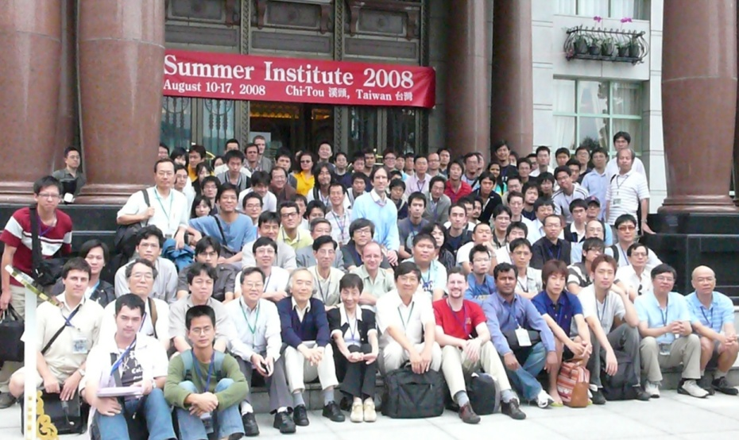
Major academic activities
Particle and fields Spring Schools (25th in 2012)
Nuclear and hadronic summer school (16th in 2012)
Particle Physics Workshops (9th in 2011)
NCTS activities (LHC, String, Gravity, Hadron, Astroparticle & Cosmology, Focus Groups)
Cross Strait Workshops
Cosmology and Particle Astrophysics (3rd this year),
Cospa Conference series (rotating internationally, 2011 Beijing); Summer Institutes (rotation among Japan, Korea, Taiwan)
Other international meetings
(FPCP, ICFP,…)
Exchange programs:
KEK;APCTP; KIAS; KIPAC; IPMU …

