Slide 1
primordial fluctuations within tele-parallelism
2012 Cross-Strait Meeting on Particle Physics and Cosmology
Yi-Peng Wu
Department of Physics, National Tsing Hua University
May 10th @ Chongquing
Collaborate with Prof. Chao-Qiang Geng
Notes:
Work with prof. CQG

Slide 2
Out-line
Introduction
teleparallel geometry
teleparallel description of General Relativity
higher-order teleparallel theory
Tele-parallel Theories for Inflation
the single field inflationary model
inflation driven by higher-order teleparallel theory
Notes:
Introduction & tele-para inflation

Slide 3
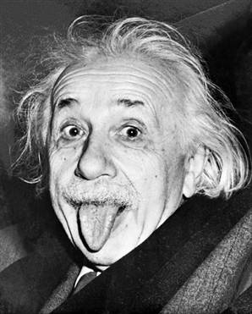
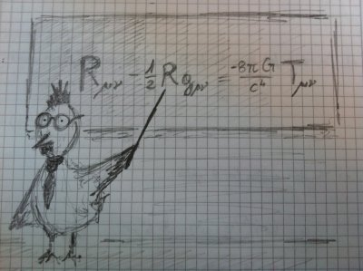
Tele-parallel geometry
The origin: an unified field theory for gravitation and electromagnetism
Nowadays: theories for gravity; geometrized by purely torsion
(1916)
gravity
(1928)
electromagnetism
Notes:
Einstein proposed tetrad field (the local frame)

Slide 4
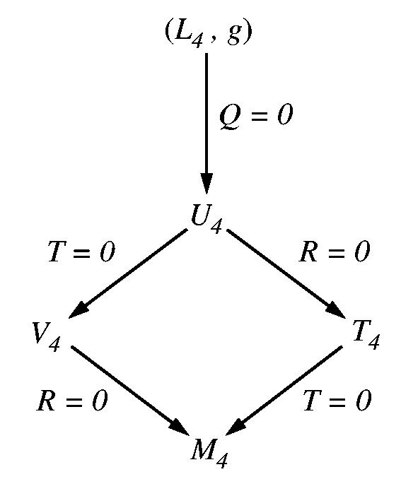
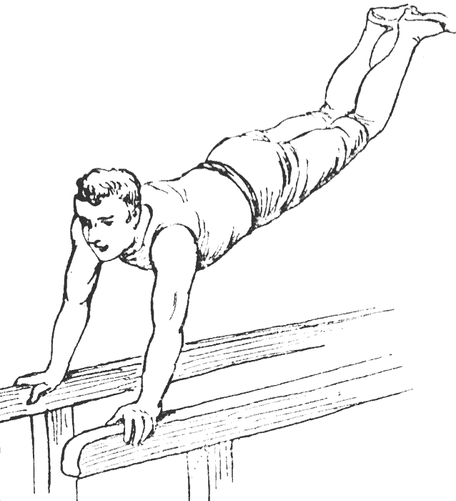
Tele-parallel geometry
curvature
Riemann
Minkowski
Notes:
A man exercise on a parallel bar

Slide 5
Tele-parallel description of GR
New General Relativity (Hayashi & Shirafuji 1979)
Teleparallel equivelance of General Relativity (Maluf 1993)
→ first order Lagrangian; second order field equation
 | GR v.s. TEGR
dynamical variable | metric | tetrad
connection | Levi-Civita | Weitzenböck
field equation | geometrically equivalence
16 components
(Einstein equation)
Notes:
Not unification theory, but gravity instead

Slide 6
Tele-parallel description of gr
The Lagrangian density of TEGR “T” differs from the Ricci scalar “R” only by a total divergence.
The field equation doesn’t determinate the entire dynamic field
Local Lorentz symmetry
Local Lorentz transformations
Notes:
T is Lorentz violating

Slide 7
Higher-order teleparallel theory
An ad hoc generalization of TEGR inspired from f(R) theories
Local Lorentz symmetry is broken
extra degrees of freedom !!
(Li, Sotiriou & Barrow 2011)
second order field equation
covariant representation
Notes:
Effective field theory

Slide 8
Tele-parallel theories for inflation
2012 Cross-Strait Meeting on Particle Physics and Cosmology

Slide 9
Tele-parallel theories for inflation
Models of inflation with observables in the framework of teleparallel geometry
Re-exam the “equivalence” of TEGR via the minimal coupling single field inflationary model
Can higher-order TEGR theories for inflation be available?
Notes:
Because TE”GR”, so we wish also to carry out the predictions

Slide 10
Tele-parallel theories for inflation
Is the “equivalence” between single field inflationary models trivial ?
Classify the teleparallel geometry:
e_{A}⁰ : (i) time-like (ii) space-like (iii) null
ADM formalism
Notes:
One Riemann correspond to a whole equivalence class of Tele
The vector in local tangent frame

Slide 11
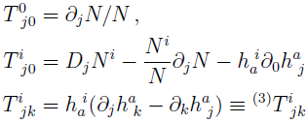
Tele-parallel theories for inflation
Teleparallel geometry with time-like e_{A}⁰
Fix the time and spatial reparametrizations
3- curvature
extrinsic curvature
ζ and γ are first order quantities
The results can be generalized to teleparallel geometry with space-like e_{A}⁰
expected results!!
Notes:
The tensor perturbations has more dof then in the content of GR

Slide 12
Tele-parallel theories for inflation
Driven inflation by modified teleparallel gravity opens up the study of f(T) theories
Conformal transformation in f(T) theories:
(Ferraro & Fiorini 2007)
still non-minimally coupled
Notes:
The first model for inflation in T-gravity

Slide 13
Tele-parallel theories for inflation
Before calculations….
(i) we need more assumptions to reduce the degrees of freedom for the flat FRW choice
(ii) the unitary field gauge δφ = 0 ?
(iii) the equivalence between conformal frames?
They are all Lorentz violated!!!
(Faraoni & Nadeau 2007)

Slide 14
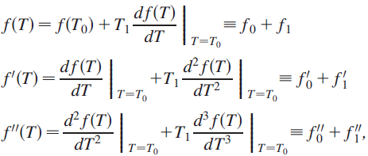
Tele-parallel theories for inflation
Linear perturbations concerning the same degrees of freedom as in GR
(Chen et. al. 2011)

Slide 15
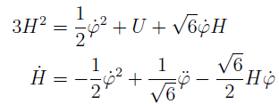
Tele-parallel theories for inflation
If the gravitational field is protected by gauge invariance (at least in the energy scale before horizon crossing) :
Extra dofs induced by Lorentz violation are supressed
The previous parametrization is applied
A single-field theory with second-order field equations:
quadratic actions
(Kobayashi, Yamaguchi & Yokoyama 2011)
background eqs.
tensor perturbations unchanged
Notes:
No new dof induced by the non-minimal coupling
At this stage, no matter about the origin of the gravity, just the time dependent parameters

Slide 16
summary
The single field inflationary model for TEGR, indistinguishable from the standard inflation results, can be realized in the certain classes of teleparallel geometry.
It is possible to carry out observables from higher-order TEGR inflation if the gravitational field is characterized by local gauge invariance.
Thank you !

